Slide 1
SOEN 6441 Advanced Programming Practices Winter 2021
Team 11
Build 3

Slide 2
Design Patterns Used:
“Each pattern describes a problem which occurs over and over again in our environment, and then describes the core of the solution to that problem, in such a way that you can use this solution a million times over, without ever doing it the same way twice.” - [Christopher Alexander]

Slide 3
Strategy Pattern: To change the behavior of an object depending on some conditions that are only to be determined at runtime, or to easily add new definitions of a certain behavior without altering the class that is using it. Adapter Pattern: it is used to be an interface, a bridge between two objects that have the same functionality, but that are to be used in a different manner, i.e. have a different specification to their interfaces

Slide 4
Project Includes
Functional Requirements
Map Editing/Loading/Saving
Game Play: Single Mode/ Tournament
Junits for each classes are implemented
Completed JavaDocs for all the files
Continuous Integration implemented and Software version repository maintained
Coding Conventions maintained and API documentation
Refactoring operation has been applied after build-2 and refactoring Document has been maintained
Goal
To develop Risk Game using given Build 3
requirements.

Slide 5
Coding Conventions
Naming Convention:
Class names in CamelCase that starts with capital letter.
Data member starts with d_
Method parameters starts with p_
Local variable starts with l_
Global variable in capital letters
Static members starts with capital letter, non static members starts with small case letters.

Slide 6
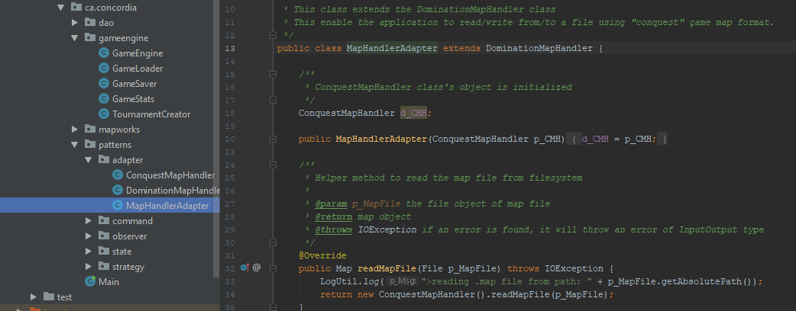
Functional Requirements: Adapter Pattern
Adapter Pattern has been implemented. To use either the original ‘domination’ file reader or ‘conquest’ file reader, map handler adapter has been introduced. After saving file, user is given the option as to which file format to use as output

Slide 7
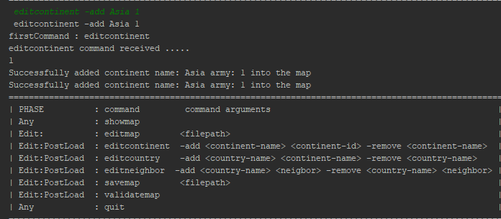
Map editing/loading/saving
editcontinent -add asia 2 -add america 3 -add africa 4
editcountry -add india asia -add china asia
editneighbor -add india china -add pak china
showmap
savemap d:\abc.map, editmap d:\abc.map
validatemap

Slide 8
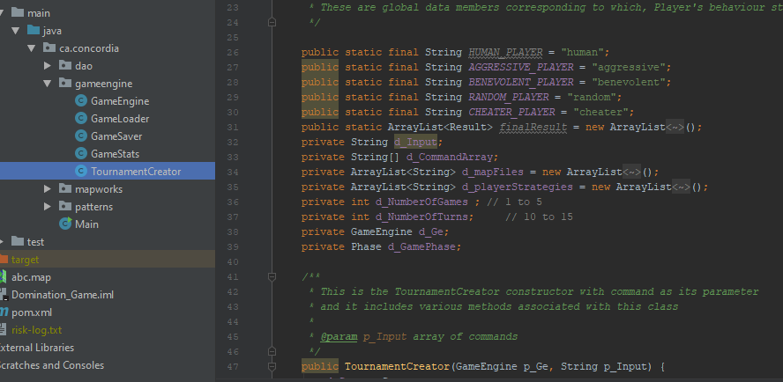
Game Play
Game is now being played in two modes-
Single game mode (with user interaction)
Tournament mode

Slide 9
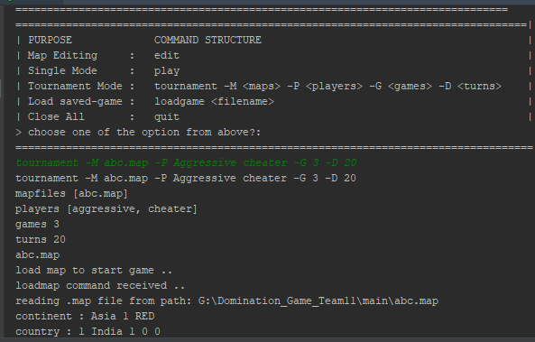
Tournament mode
Starts with user choosing maps(1 to 5),Player strategies(2 to 4),Games played on map(1 to 5), Maximum no. of turns for each game(10 to 50). Automatic game without user interaction
Tournament –M listofmapfiles –P listofplayerstrategies –G numberofgames –D maxnumberofturns

Slide 10
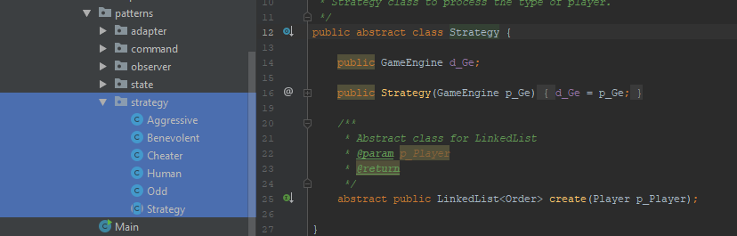
Player Behavior Strategies(Strategy Pattern)
Player’s issueOrder() method’s behavior is using Strategy pattern.
Human
Aggressive
Benevolent
Random
Cheater

Slide 11
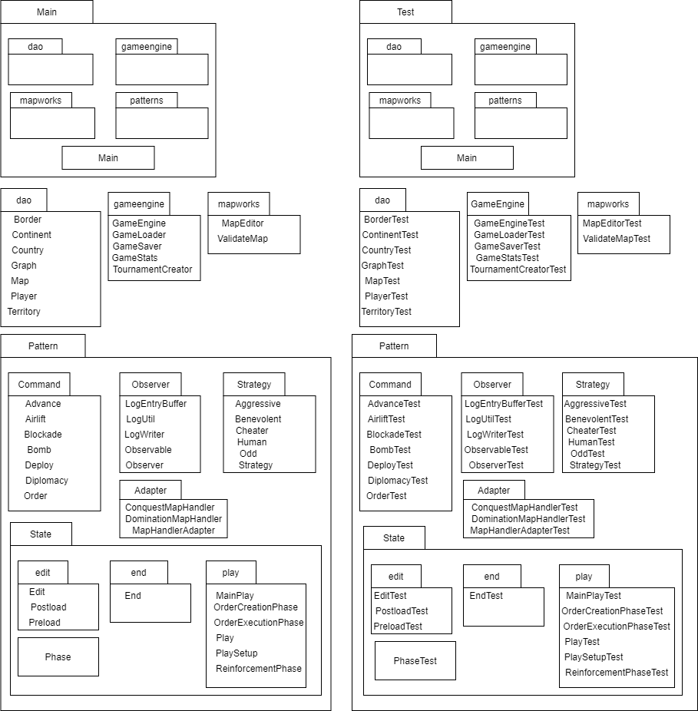

Slide 12
Thank you!

